Slide 1

dfm_tools
A Python package for D-FlowFM input and output
Jelmer Veenstra

Slide 2


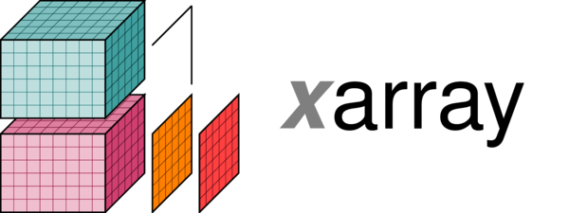




dfm_tools: the concept
What:
a Python package for pre- and postprocessing D-FlowFM input and output files
contains convenience functions built on top of other packages like xarray, xugrid, hydrolib-core and many more
Why:
sharing of workflows among users (colleagues/external)
no need to reinvent the wheel
developments driven by projects like hydrolib-core, MassBay, FutureMares, TCOMS
Where:
code on github: https://github.com/Deltares/dfm_tools
installable via pip
jupyter notebooks and binder with example code

Slide 3
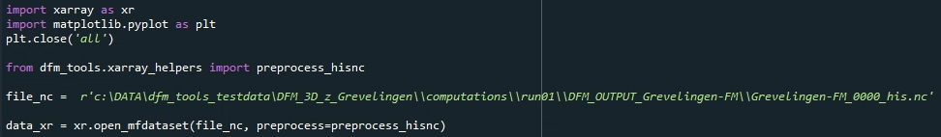
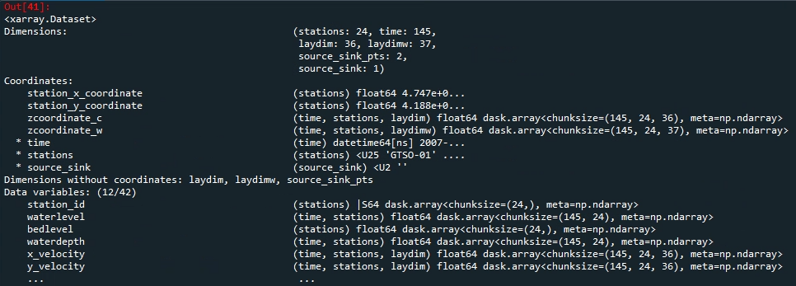
xarray: io of netcdf files
lazy loading of netcdf files with knowledge of the entire structure
easy indexing over all dimensions with .isel() and .sel()
preprocess_his() enables indexing via station names (and other labels)

Slide 4
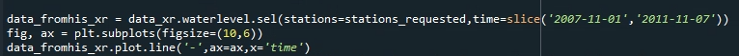
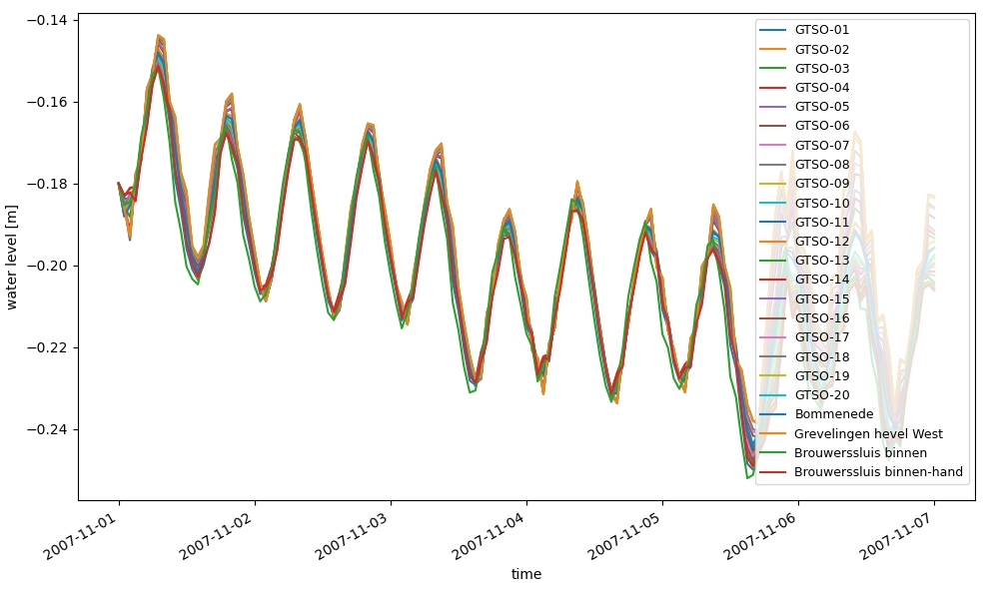
xarray: plotting of netcdf files
easy indexing (subsetting)
easy and complete plotting
.../tests/examples/postprocess_hisnc.py

Slide 5

HYDROLIB: io of D-FlowFM input files
Core scripts & tools for interaction with D-FlowFM:
reading/writing of (almost all) D-FlowFM input files (mdu, ext, bc, pli, etc)
full functionalities: https://deltares.github.io/HYDROLIB-core/0.3.1/topics/dhydro_support/
supported, documented, maintained
available on github: https://github.com/Deltares/HYDROLIB-core
users do not need to re-invent the wheel about “basic stuff/file formats”, focus on the analysis itself

Slide 6
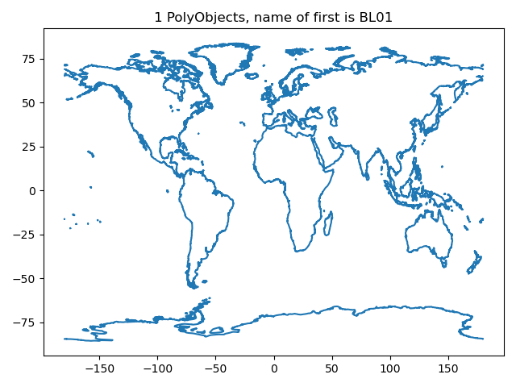
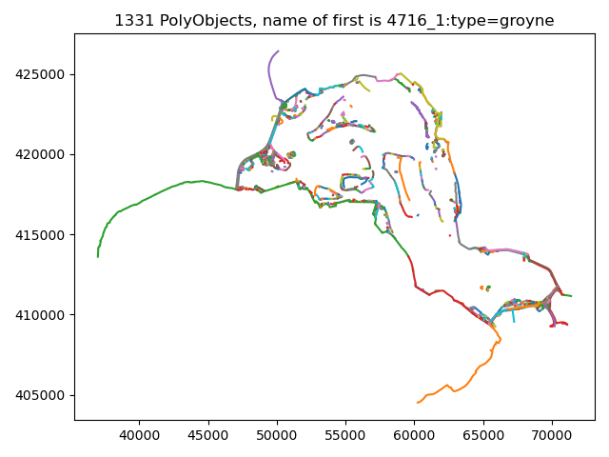
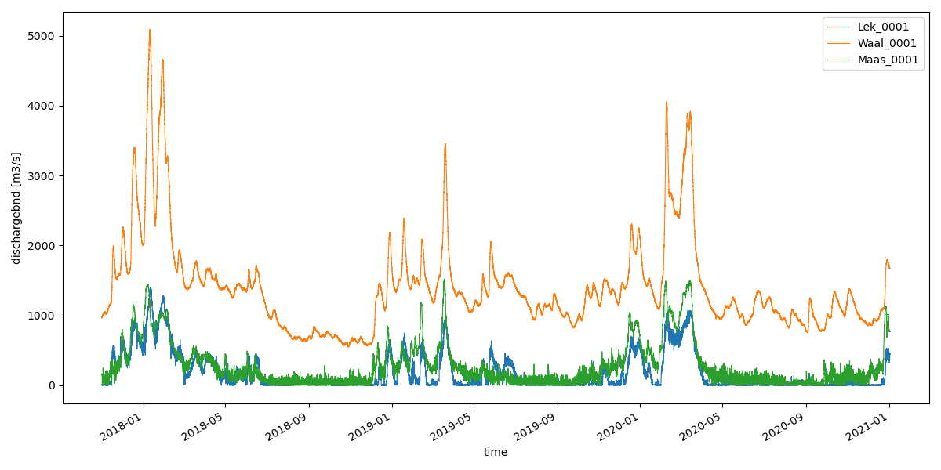
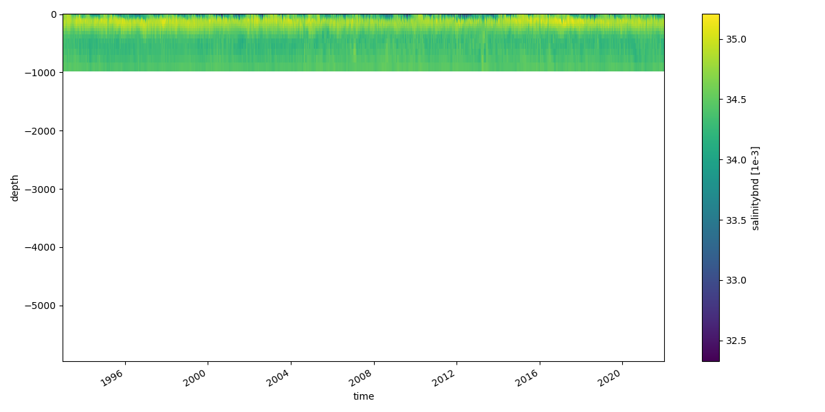
Examples: reading+plotting of D-FlowFM input files
hydrolib for reading files
conversion to xarray/pandas dataset with dfm_tools
figures: pli/pliz/ldb/tek and bc files
.../tests/examples/preprocess_hydrolib_readbc.py
.../tests/examples/preprocess_hydrolib_readwritepol.py

Slide 7
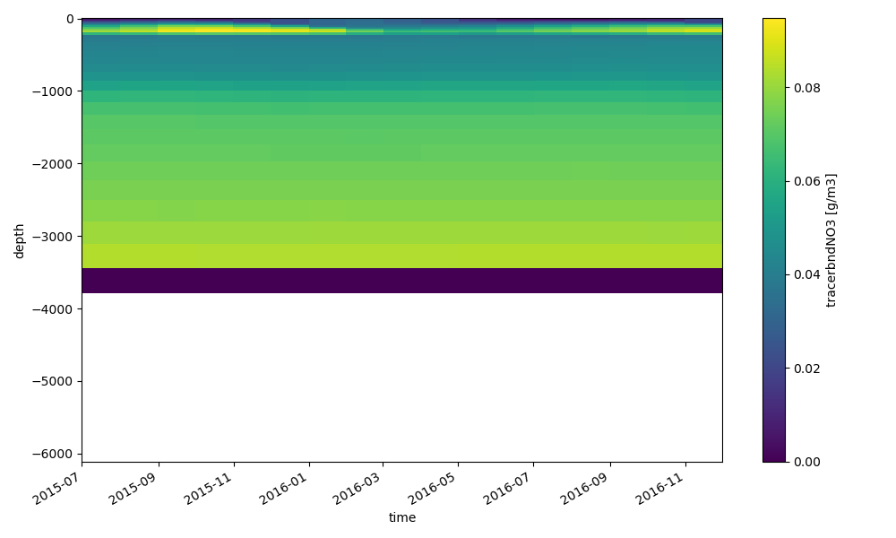
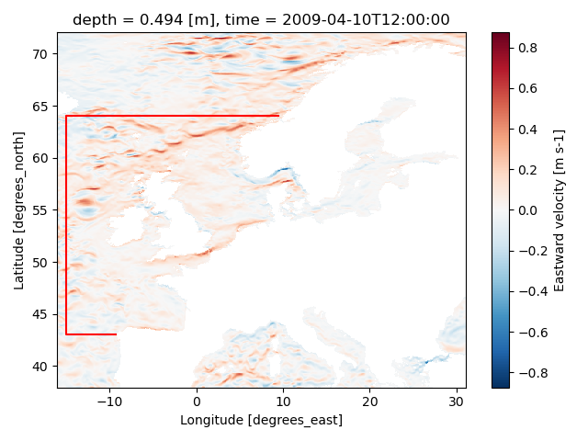
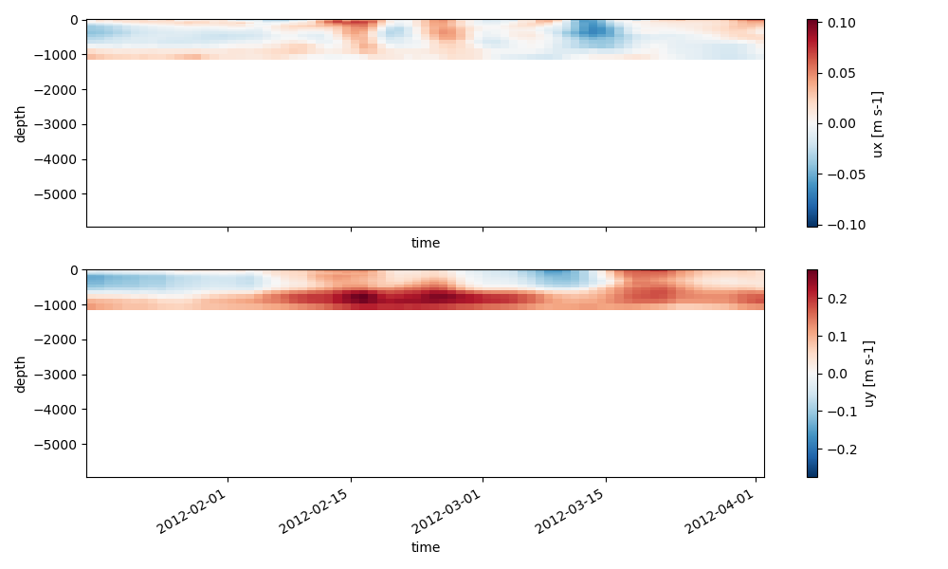
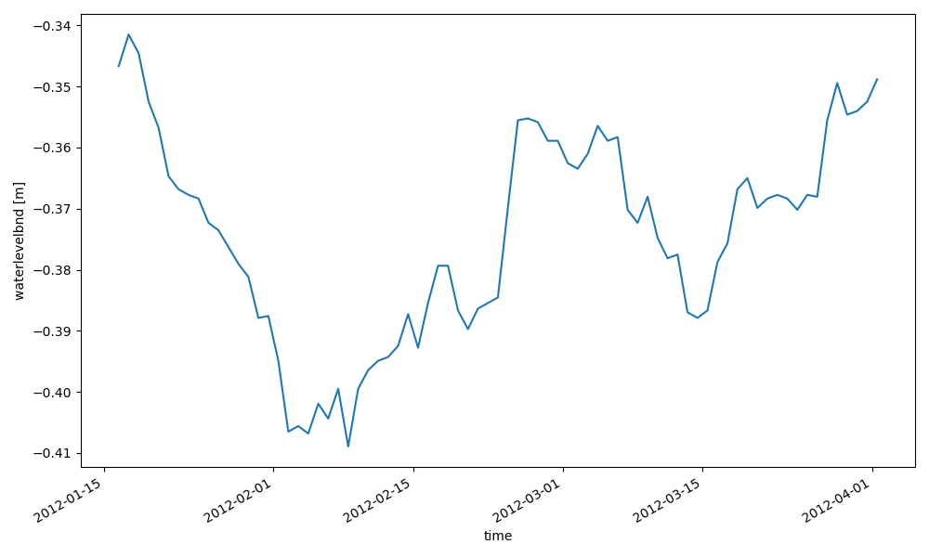
Examples: interpolate oceanmodel to bc
xarray for reading netcdf data and .interp() to polyline points
hydrolib for reading pli and writing bc/ext files
.../tests/examples/preprocess_interpolate_nc_to_bc.py

Slide 8
Application for regional models
Manually defined model boundaries, used for:
Grid cut-out of GTSM (currently manual)
Download of ERA5 and CMEMS field
.../tests/examples/download_meteodata_oceandata.py
Generation of (2D) open boundary forcing from FES2014 (tidal constituents)
.../tests/examples/preprocess_interpolate_nc_to_bc.py
Generation of (3D) open boundary forcing from CMEMS (salinity, temperature and sealevel anomaly)
.../tests/examples/preprocess_interpolate_nc_to_bc.py
Generation of 3D initial fields from CMEMS (salinity and temperature)
.../tests/examples/preprocess_ini_cmems_to_nc.py
Generation of meteorological forcing fields
.../tests/examples/preprocess_meteo_mergenetCDFtime_xarray.py
The dfm_tools enables the quick set-up of the basis of a 3D model

Slide 9
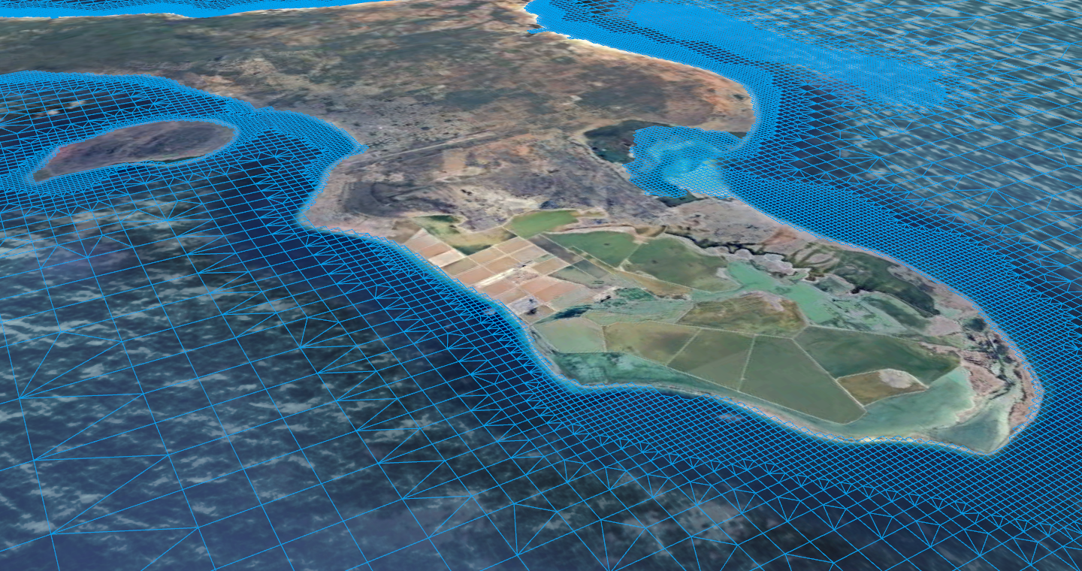
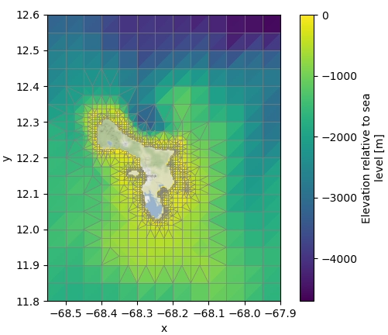
Combined into 3D Model Builder
Based on bounding box and period of interest, a 3D D-Flow FM model is created from global datasets:
Using Python libraries HYDROLIB-core, dfm_tools, MeshKernelPy, xarray and others
Grid generation and refinement (based on local water depth)
Bathymetry (GEBCO) retrieval and interpolation to grid
Initial and open boundary conditions: ocean currents, sea surface heights, salinity, temperature from CMEMS, tide from FES2014
Meteorological forcing: ERA5

Slide 10
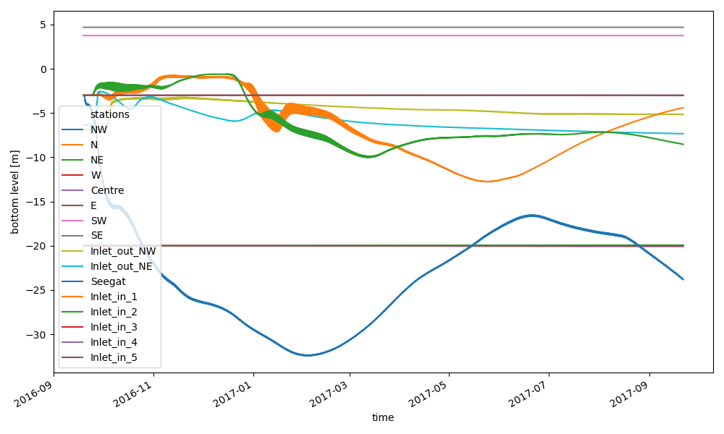
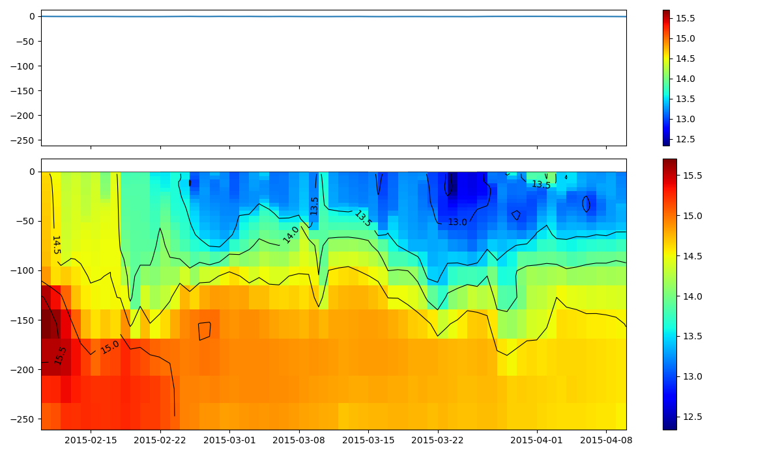
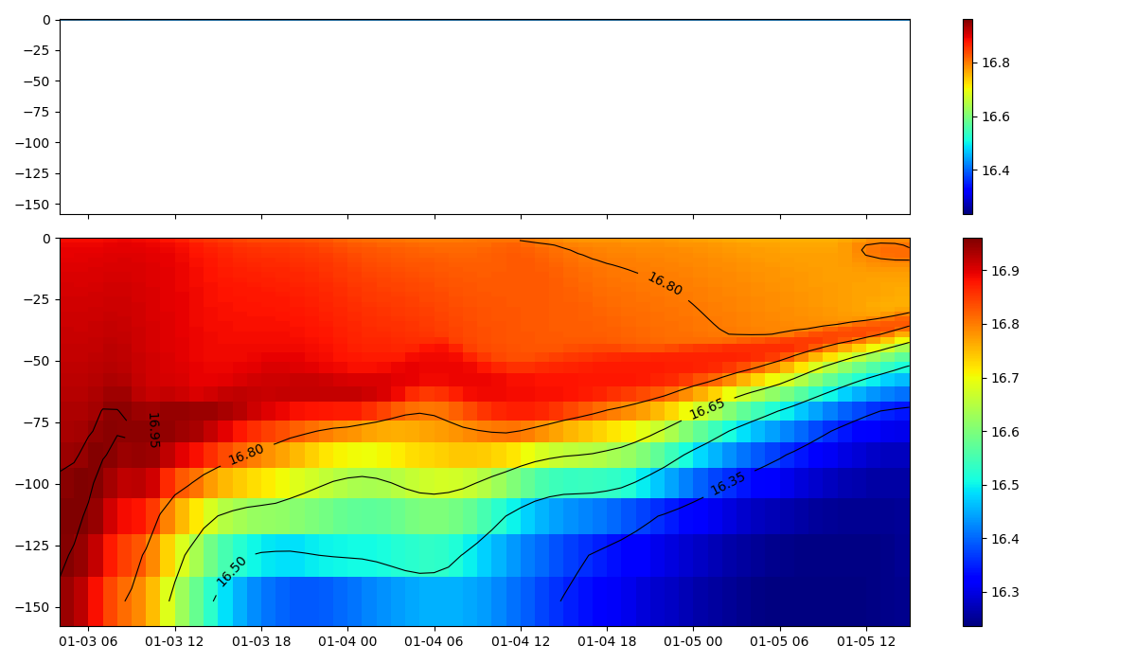
Examples: read+plot hisfile
xarray for reading hisfile (D-FlowFM and sfincs)
easy retrieval of lists of stations, cross_sections, general structures, etc thanks to preprocess_hisnc()
selection of data over dimensions: time, depth, stations, cross_sections, structures, etc
zt-plot (timeseries of one point with depth dim)
.../tests/examples/postprocess_hisnc.py
coming up:
interpolation
nesting

Slide 11
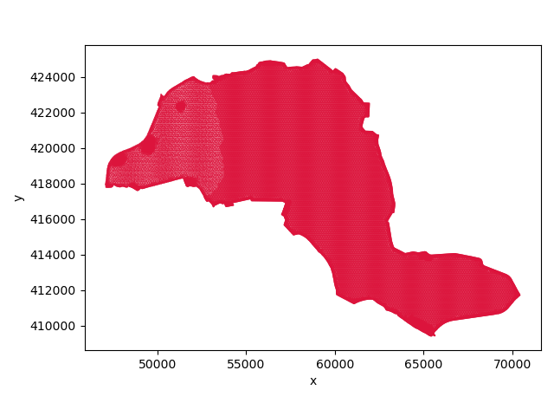
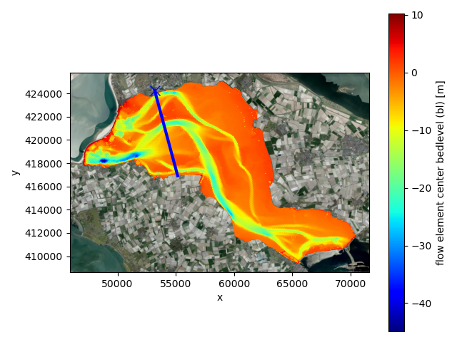
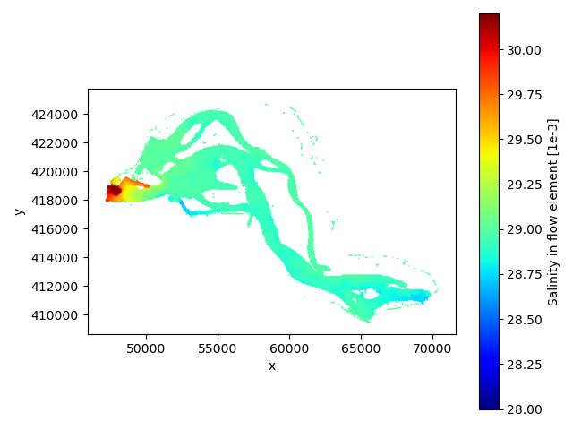
Examples: read+plot mapfiles
xarray/xugrid for reading D-FlowFM (unstructured) map/fou/rst/net files
supports partitions (handling of ghost cells)
select data based on variable and dimensions (time/layer/etc)
satellite backgrounds with contextily
3D slicing (horizontal/vertical): next slides

Slide 12
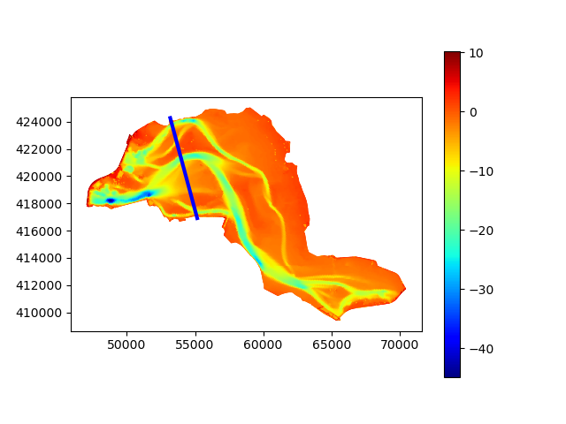
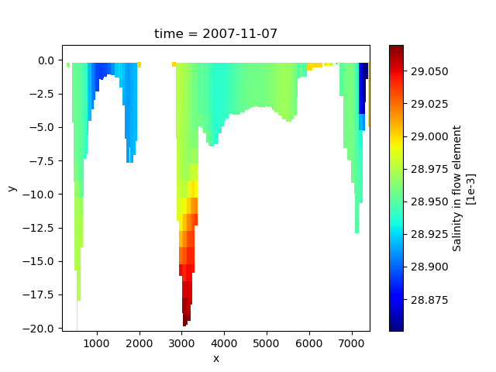
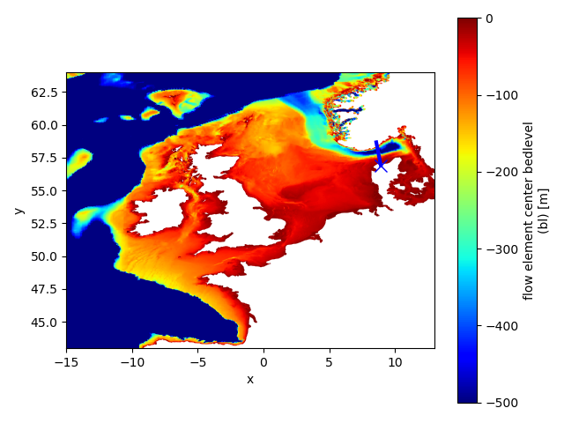
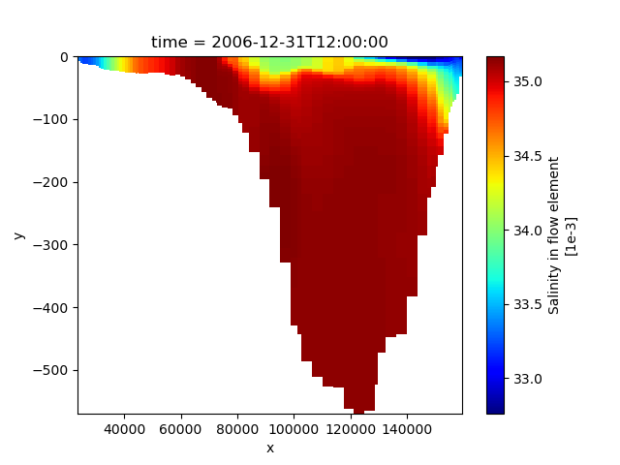
Examples: cross section trough 3D partitioned FM map data
given a polyline (blue)
slice trough 3D partitioned FM map data
returns an xugrid DataArray so plotting is easy
also possible to select values based on depth w.r.t. z0/wl/bl

Slide 13
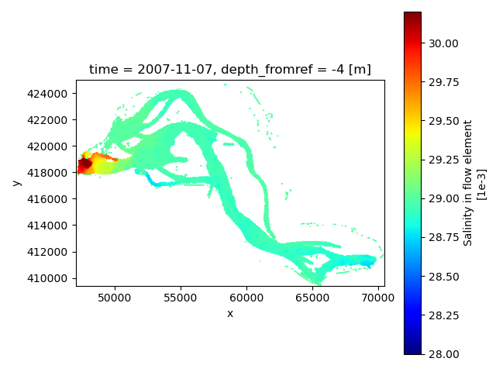
Examples: slice trough 3D partitioned FM map data
given a depth w.r.t. z0, waterlevel, bedlevel
slice trough 3D partitioned FM map data
multiple depths supported
support for sigma, z and zsigma layers
also implemented for hisfiles

Slide 14
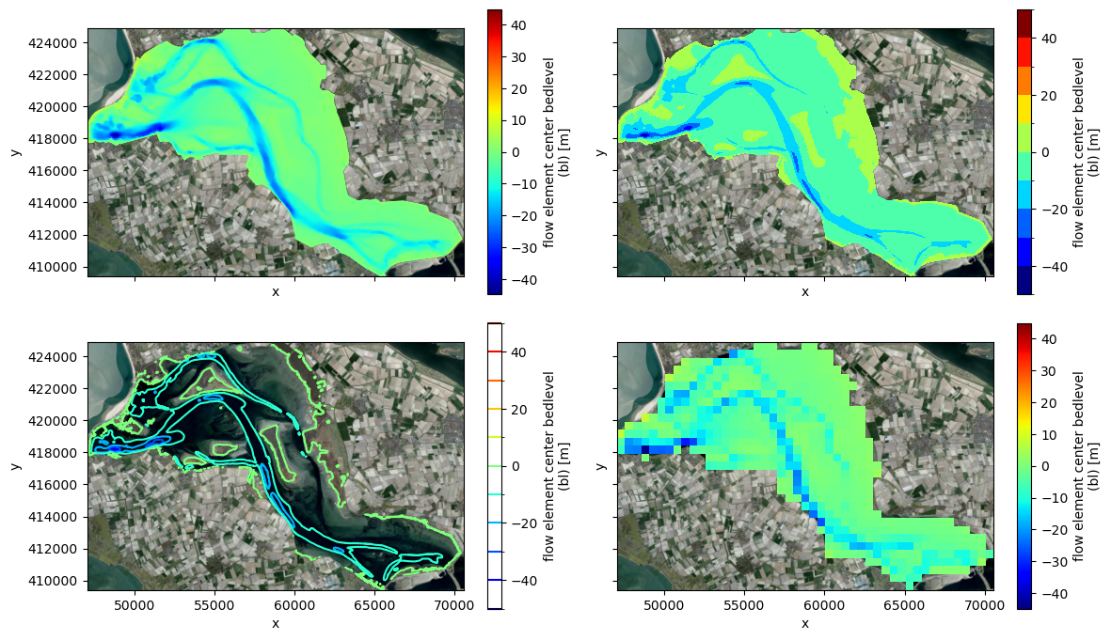
Examples: various plotting options
Easy to create fancier plots like contourf or contour
Rasterization to regular gridded dataset for e.g. different-grid comparisons
backened by xugrid and xarray
More examples in the xugrid docs

Slide 15
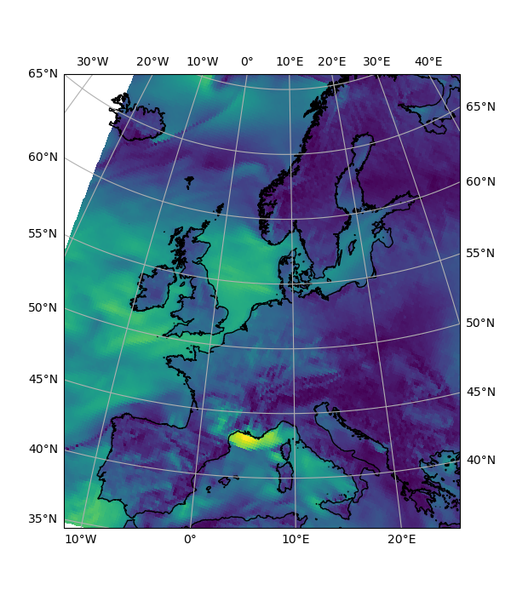
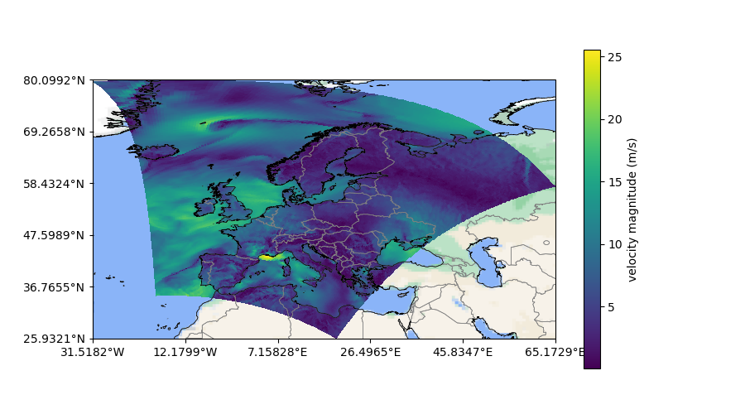
Examples: cartopy basemaps and coastlines/borders
support for almost any epsg

Slide 16
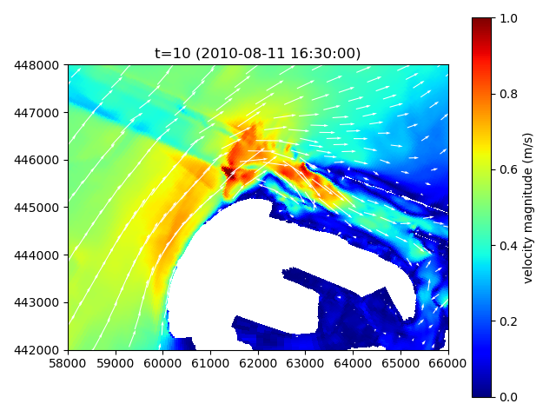
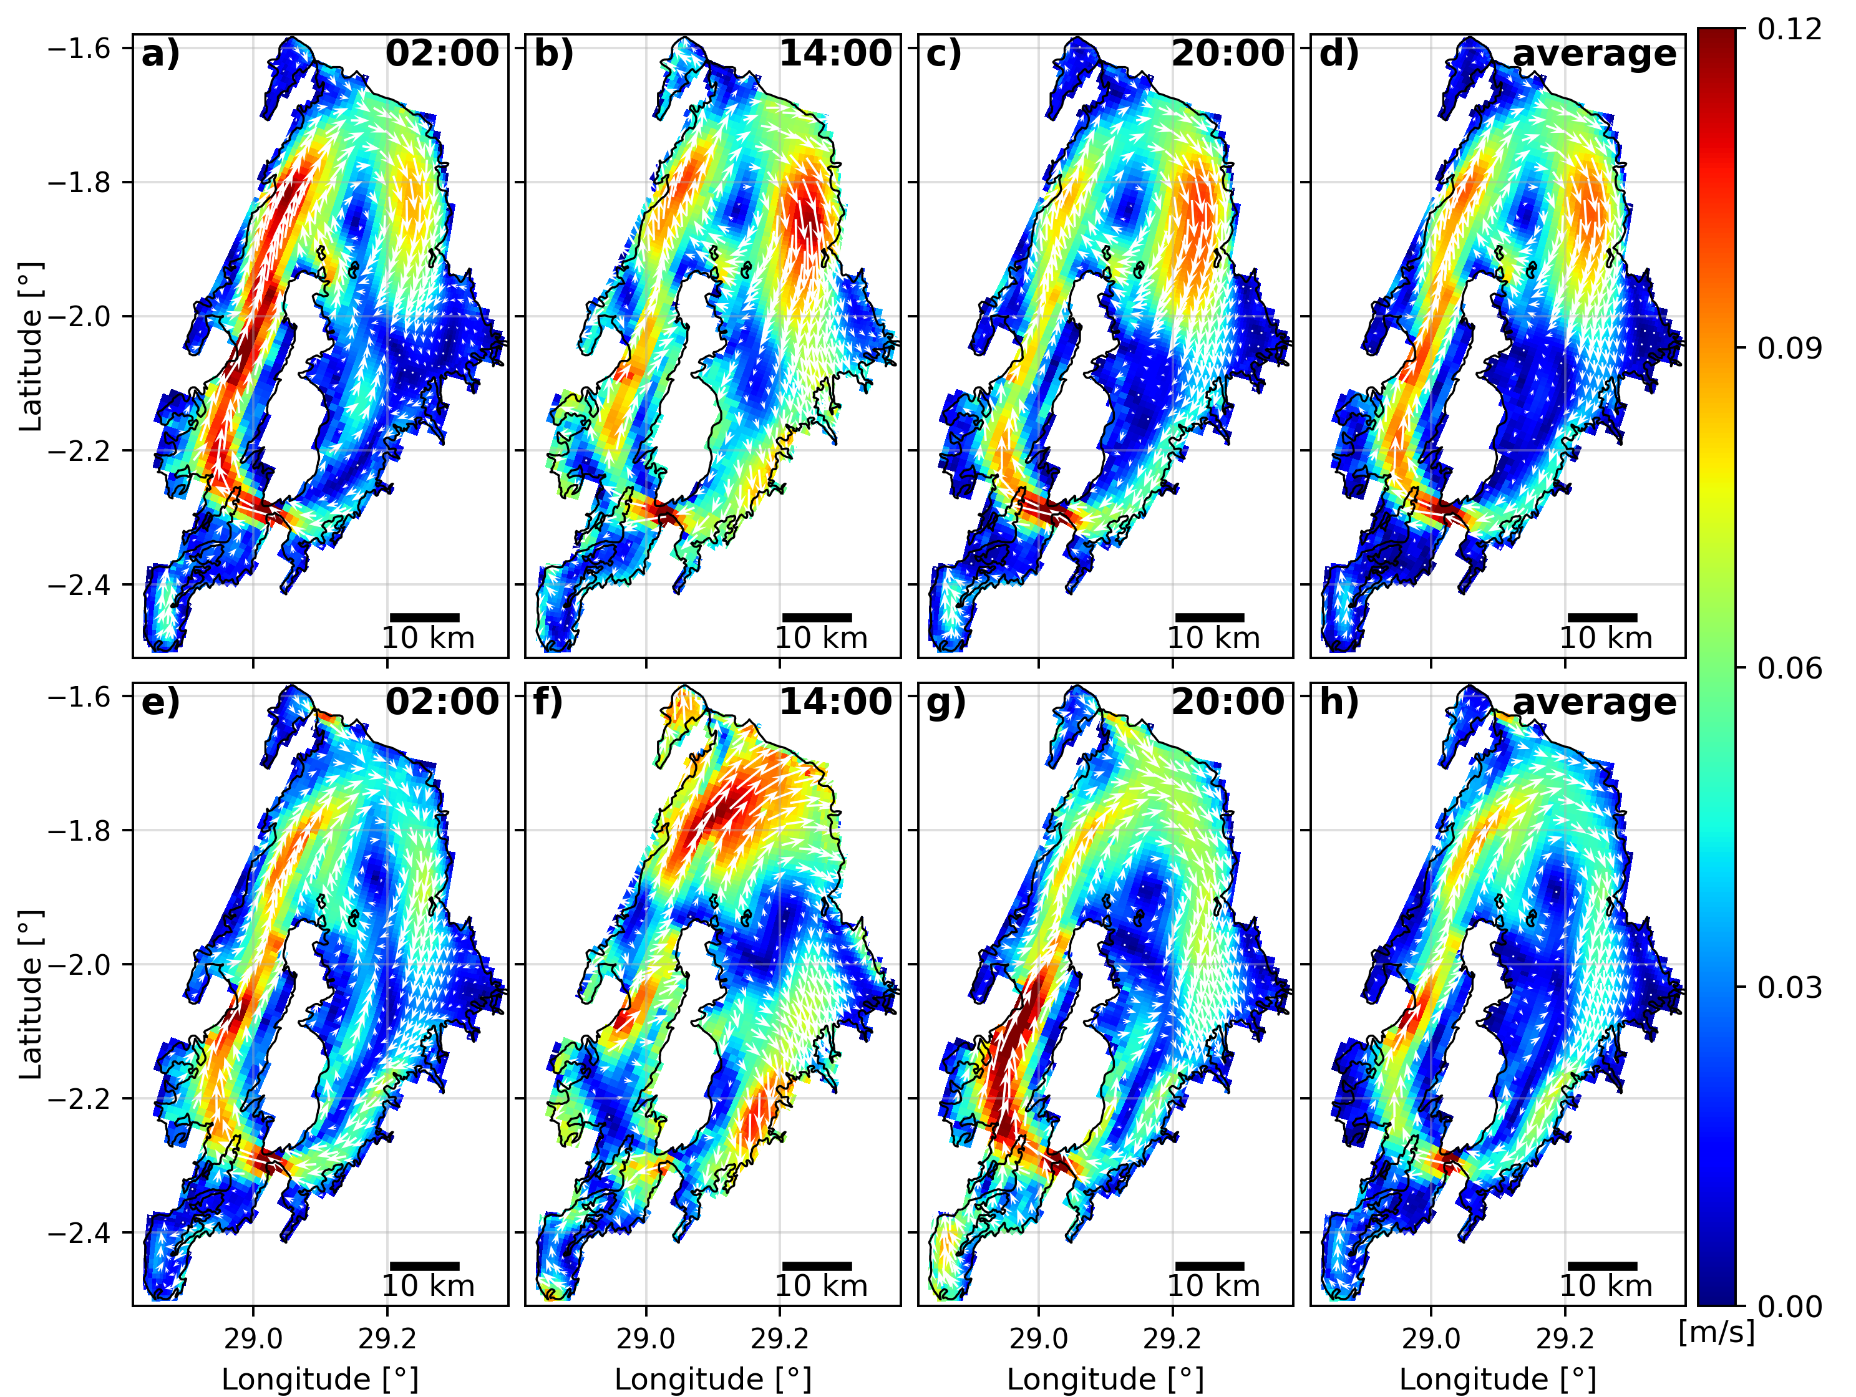
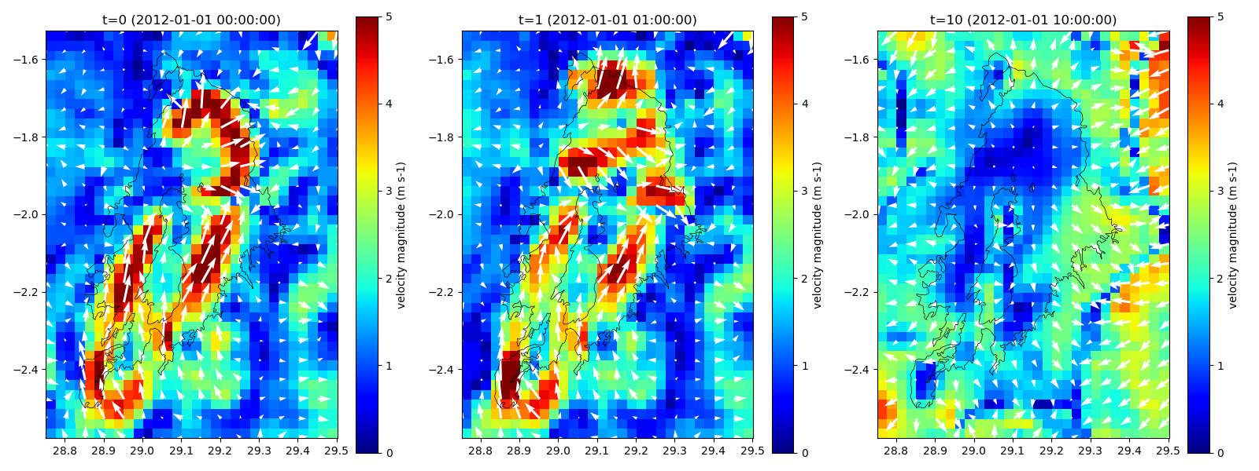
Examples: vector plots for regulargrids
support for any other netCDF
e.g.: SFINCS, Delft3D4, oceanmodels, meteomodels

